Slide 1
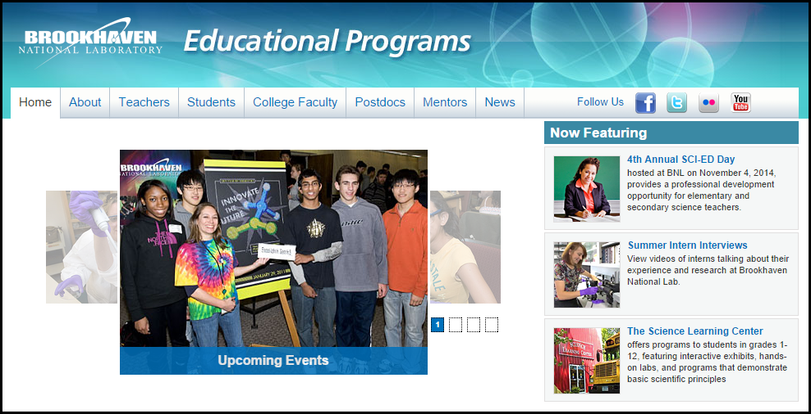
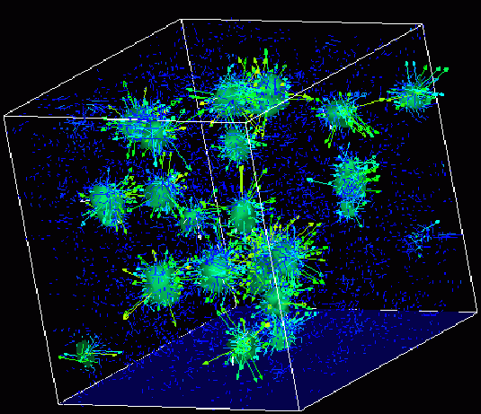

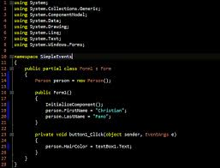
Advanced
Scientific Computing
(SciComp 201)
Session 01
Course Overview, Classroom Rules,
Hello Problems

Slide 2
Hello Problems!
Find the underlying functional equation that generates this series, $where n≥1 and a_{1}=2,a_{2}=−1,etc$:
$$a_{n}=2, −1, 1, −\frac{1}{2},\frac{2}{3},−\frac{1}{3},\frac{1}{2},−\frac{1}{4},\frac{2}{5},−\frac{1}{5},\frac{1}{3},−\frac{1}{6},…$$
Hint: Rewrite some terms as un-simplified fractions – what pattern do you now see in the numerators & denominators?
$$a_{n}=\frac{2}{1}, \frac{−1}{1},\frac{2}{2}, \frac{−1}{2},\frac{2}{3}, \frac{−1}{3},\frac{2}{4}, \frac{−1}{4},\frac{2}{5}, \frac{−1}{5},\frac{2}{6}, \frac{−1}{6},…$$

Slide 3
Hello Problems!
This classic equation for a line: $y=mx+b$ cannot represent a vertical line since neither of the available unknowns $(m,b)$ are coefficients of the $y$ term.
The Radon projection is an equation having only two unknowns $\left(θ,d\right)$ that can represent any and all lines, including both horizontal and vertical lines
$$x\cos{θ}+y\sin{θ}=d, where \left\{θ,d∈ℝ\right\}$$
$$and −∞≤d≤∞, 0≤θ<π$$
Find the equation $x=f(θ,d,r)$ that represents the intersection of the Radon line and the circle $x^{2}+y^{2}=r^{2}$

Slide 4



Welcome!
My name is Dave Biersach
I am a Technology Architect at BNL
I am a 1989 graduate of West Point and served in the Persian Gulf War as a Combat Engineer Officer
I did my graduate work at NPS in optimal satellite counter-reconnaissance search algorithms for DARPA
I am married with children in college and have mentored students for 15 years

Slide 5
Welcome!
I wrote all of the code you are going to see in this workshop
You can email me at scicomp@bnl.gov
I am already proud of you!
You all completed a very challenging pre-test
You are giving up two full weeks in the middle of summer
You are pushing yourself to try something new
You are doing all of this because you want to learn
I salute your efforts and the support of your parents!

Slide 6
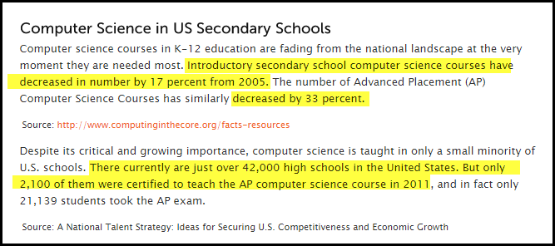
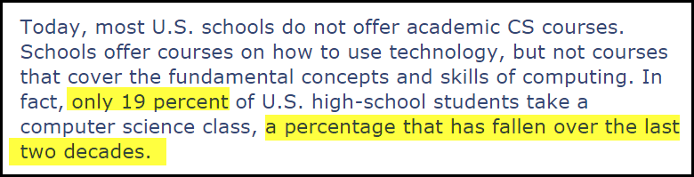
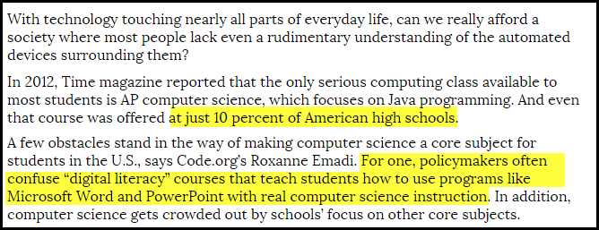
A National Challenge

Slide 7
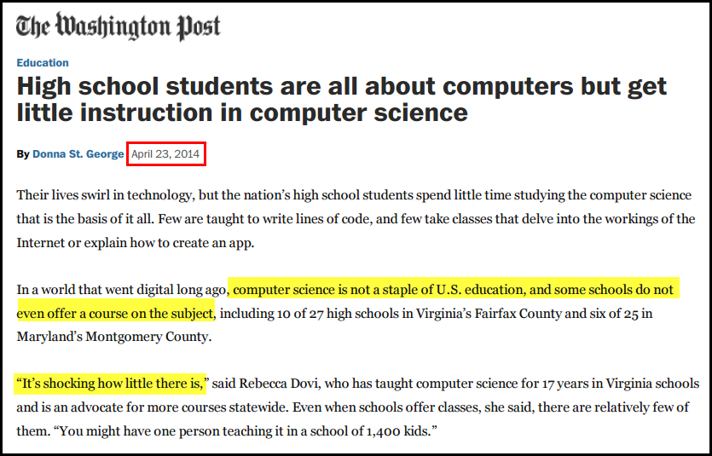
A National Challenge

Slide 8
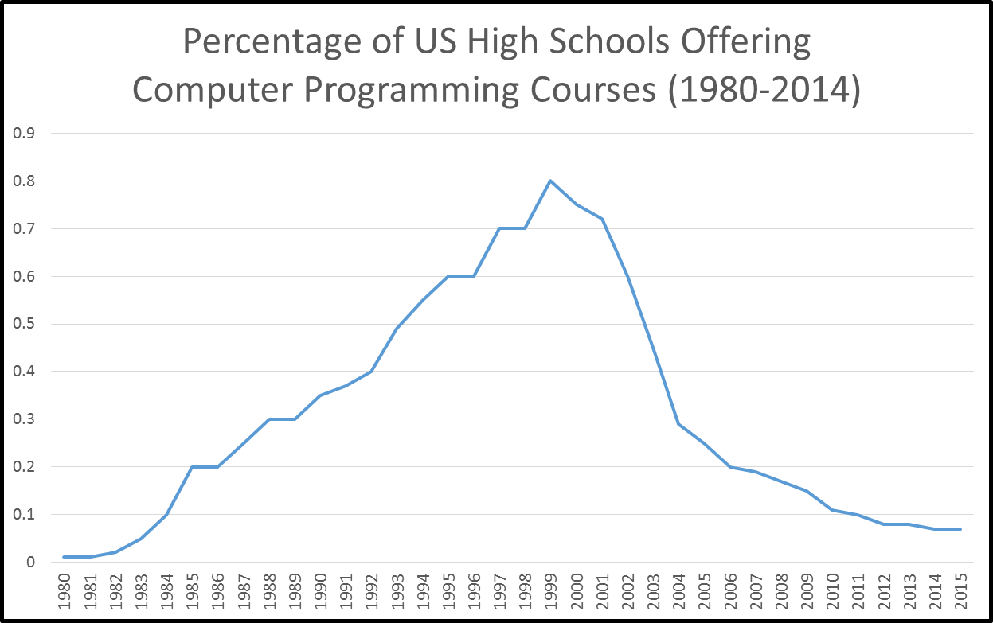
A National Challenge
2015 - National Center for Education Statistics, Dept. of Education

Slide 9
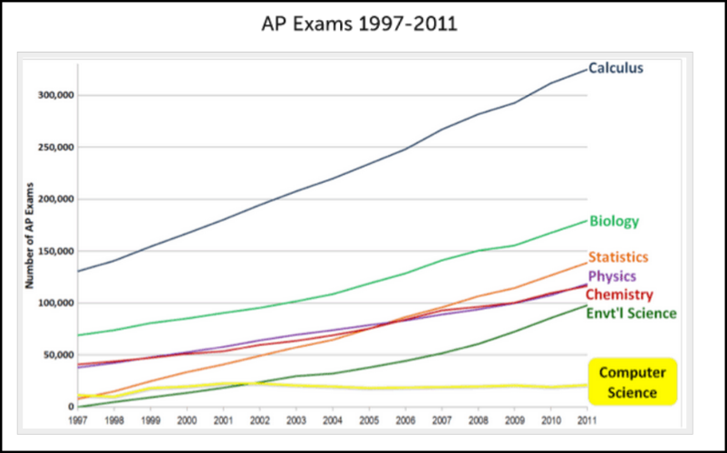
A National Challenge

Slide 10
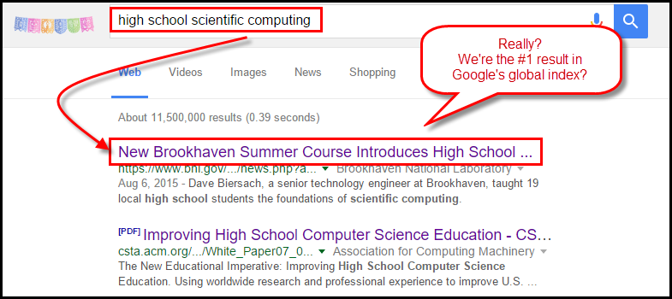
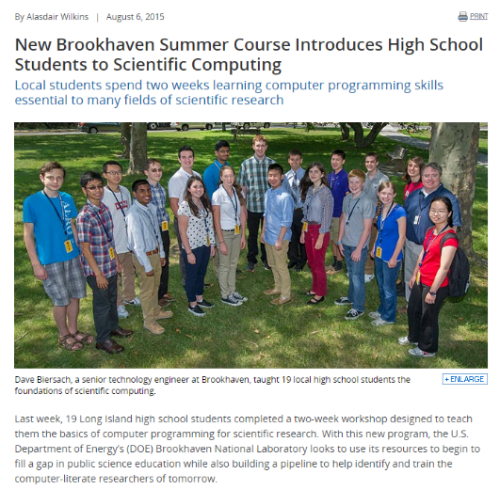
A National Challenge

Slide 11
The Challenge to DOE
Scientists across DOE have noted a dramatic rise in the startup latency of interns who do not possess foundational programming skills
This latency means that for the initial 6-8 weeks of their assignment, the interns are essentially unproductive as they must first acquire basic knowledge of how to write software
Instead of learning key scientific principles from their mentor, the interns are spending their precious lab time often working alone, figuring out how to instruct the computer to perform rudimentary data processing tasks
From the perspective of DOE scientists, the need to adeptly wield software tools has never been as urgent as it is today

Slide 12
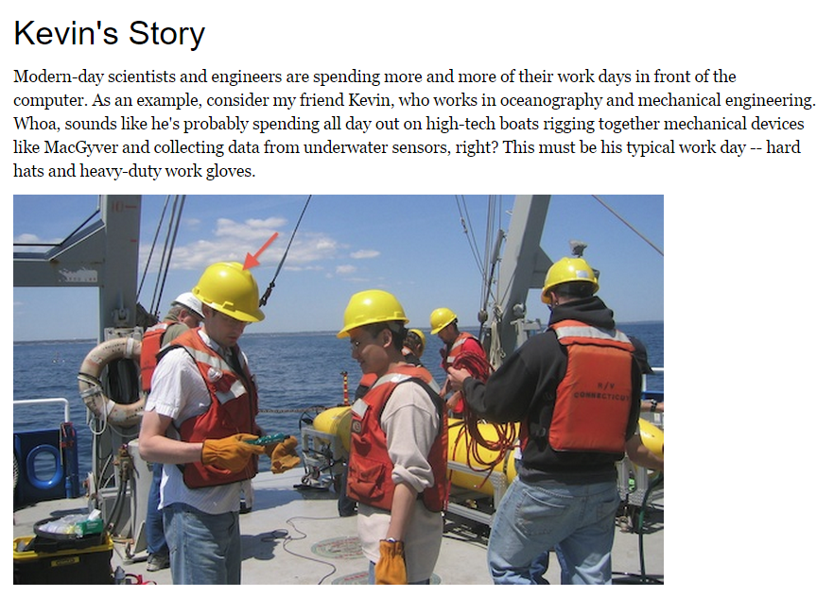
The Hype

Slide 13
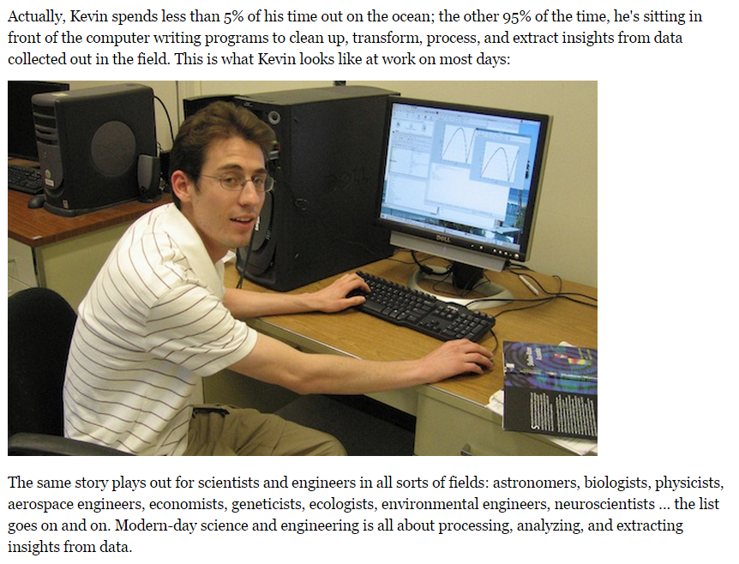
The Reality

Slide 14
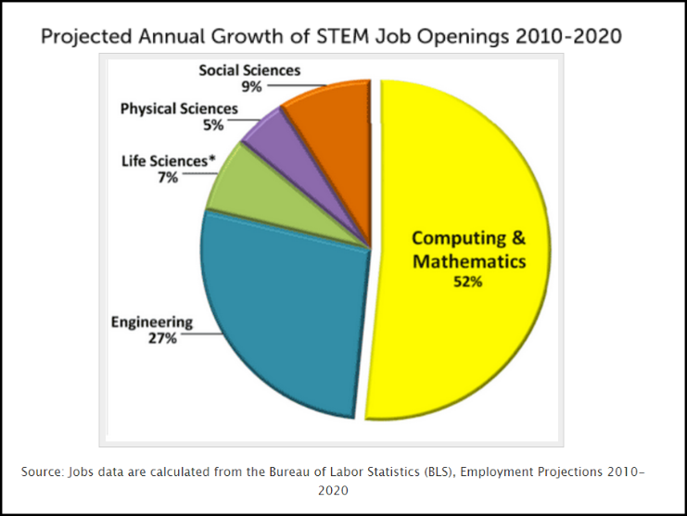
The Irony

Slide 15
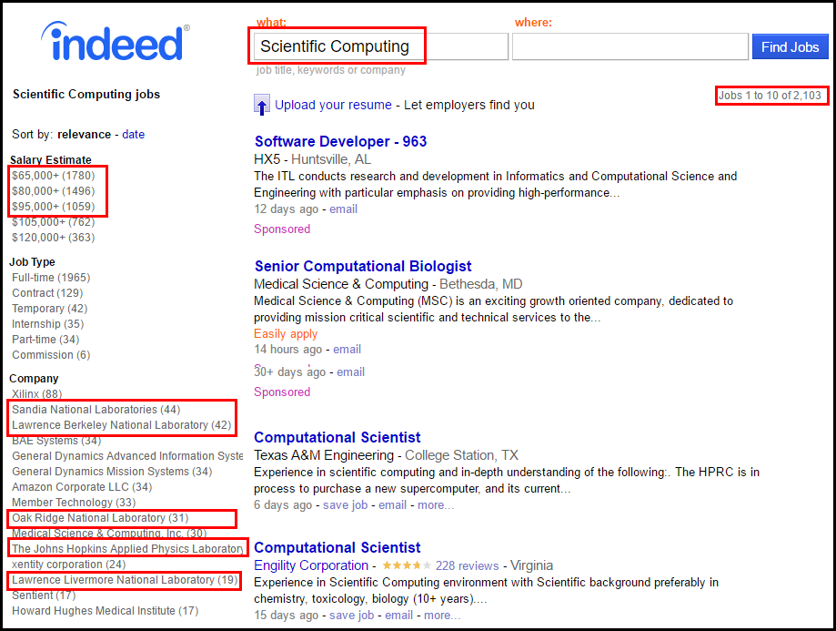
SciComp = Pathway to Internships

Slide 16
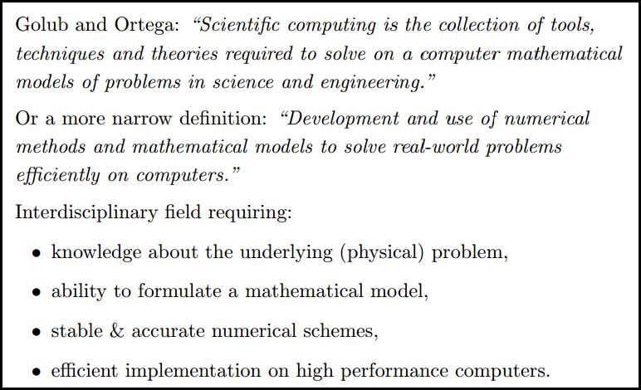

What is Scientific Computing?

Slide 17
SciComp vs CompSci
Scientific Computing
Computer Science
Probability and Statistics
Simulation and Modelling
Data Visualization
Storing and Analyzing Very Large Datasets
Parallel & Distributed Algorithms
Speed and Accuracy Paramount
Functional Languages
Open-Ended Problems with Unknown Solutions
General Data Structures
Design Methodologies
Procedural Languages
Stand-Alone Programs
Emphasis on Object-Orientation
Simple Data Models
Sequential Algorithms
Less Graphics Intensive
Directed Closed-Form Problems with Known Solutions

Slide 18
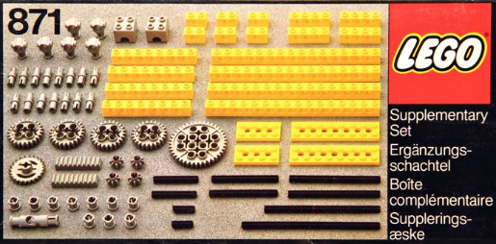
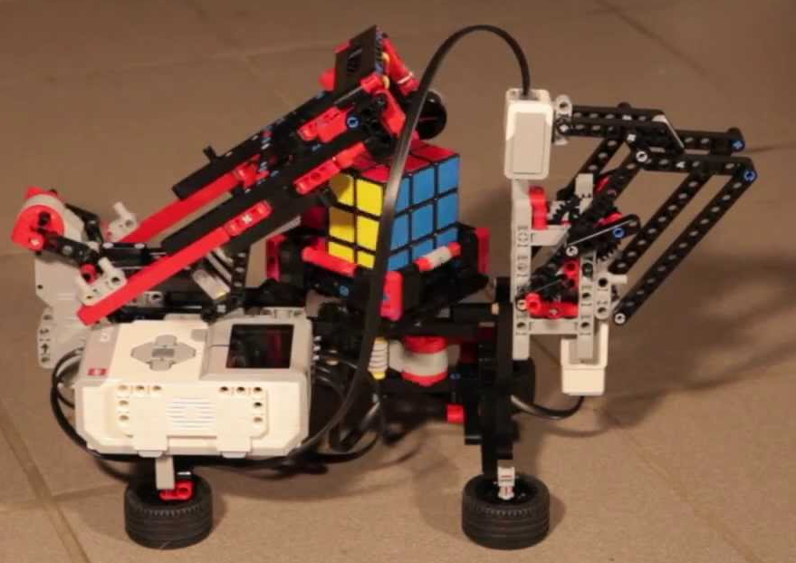
SciComp = Just Enough CompSci
Data types: int, double, bool, string
Data structures: arrays, lists, streams, classes
Statements: for(), while(), if(), return
Patterns: brute force, recursion, divide & conquer, map-reduce
Algorithms: GCD, mean/variance, sorting, searching
Helpers: Random, mod %, Stopwatch, Allegro, ROOT

Slide 19
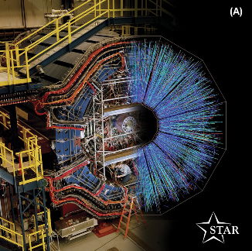
Workshop Goals
Stimulate student curiosity in what is possible with computers
Introduce a broad range of terms and concepts
Show how complex programs use the same basic Lego blocks
Solve actual science problems by writing custom code
Allow students to continue learning at home via the cloud

Slide 20
Mathematical Concepts
Analytic Number Theory
Continued Fractions
Representation Theory
Systems of Linear Equations
Lagrangian Interpolation
Quadratic Least Squares Fitting
Stochastic Processes
Numerical Integration
Differential Equations
Dynamical Systems
Set Partitioning
Computational Geometry
Game Theory
kMeans Clustering
Discrete Fourier Transforms
Complex Exponentiation
Euler’s Identity
Euler’s Constant
Euler’s Line
Riemann Hypothesis

Slide 21
Science Concepts
Bohr Nuclear Model
Rydberg Spectral Emission
Radioactive Decay
Brownian Motion
Equilibrium Simulation
Balancing Ionic Equations
Harmonic Oscillation
Nyquist Aliasing
General Relativity
Orbital Mechanics
Sunspot Activity
Turbulence

Slide 22
Computer Science Concepts
Binary Encoding
Random Number Generation
Strings, Arrays, Operators
Loops, Functions, Recursion
Recursion with Backtracking
Combinatorics
Allegro Graphics Library
CERN ROOT Library
Oblique Projection
Digital Logic Circuits
Data Files with HDF5
Monte Carlo Integration
Threading
Synchronization Primatives
Parallel Algorithms
Lossless Compression
Digital Circuit Design
Discrete Event Simulation
Runtime Complexity
Code Instrumentation

Slide 23
Classroom Rules
Cell phones on silent and use them only during breaks
Don’t interrupt me or other students – that is rude
Do not shout out answers
Stay in your seats except during breaks
“Eyes on me” means you must fully close your laptop
Don’t ask me for help before trying your very hardest
Help each other during the labs
Complete the labs! (I will be checking them nightly)

Slide 24
My Expectations
You will usually feel lost – learn how to deal with that
This is not a school and I am not a teacher
This is going to be intense, we are going to move fast!
First figure out how you would solve the problem by hand
Design it on paper before you write a single line of code
My slides are barren – I expect you to take notes on them!
If you show me real effort and excellent results, I would be glad to write a letter of recommendation for your college application & to help you seek future internships at BNL

Slide 25
Daily Schedule
Four classes daily
30 min demonstration
60 min hands-on lab
Two break periods
Hour lunch at Berkner Hall
Classroom is open 8:00 – 5:30
I can be available after 5:00 for anyone needing extra help with the lab assignments
8:30 – 9:30 Demo 1
9:30 – 10:00 Class 1
10:00 – 10:30 Break
10:30 – 11:30 Demo 2
11:30 – Noon Class 2
Noon – 1:00 Lunch
1:00 – 2:00 Demo 3
2:00 – 2:30 Class 3
2:30 – 3:00 Break
3:00 – 4:00 Demo 4
4:00 – 4:30 Class 4
4:30 – 5:00 Open

Slide 26
Session Topics & Labs – Week 1

Slide 27
Session Topics & Labs – Week 2

Slide 28
This is a 200-level course
C++ is the most heavily used language in science and professional programming – for large scale projects
All major modern operating systems are written in C++ including Windows, Linux, Android, MacOS & iOS
You should always know the language of your operating system – like you should always know the architecture & assembly language of the CPU you are using
GPU coding (nVidia, Radeon, etc) is all done using C++
All major video games are written in C++ (even Minecraft was re-written from Java into C++)
BNL uses C++ and Python almost exclusively

Slide 29
This is a 200-level course
SciComp 100/101/102 was “fill-in-the-blanks” coding, but SciComp 201 provides much less scaffolding
I will give you a high level description of the problem to be solved, and a few representative Lego blocks (C++ language constructs and/or algorithms) that you’ll need to harness to solve the problem – but the rest is up to you alone
Get used to solving problems on your own and with the help of your peers. This is how college works.
I will give advice and hints – but don’t ask me to magically and instantly debug your code – you need to fix it!
There is this great thing called Google… use it!

